Slide 1
The Gospel of Mark

Slide 2
Characteristics of Mark
It is the second Gospel in terms of positioning, likely the earliest written
Within a few decades of the Resurrection, unclear if the Temple had been destroyed yet
Likely written just around the death of Peter
It is the shortest Gospel; 16 chapters
Presumes the reader knows the story:
- A little confusing; start stories or episodes in the middle
- It is not orderly, jumps around a bit, but accurate
It is often called the common Gospel, 90% of the stories are found in the other synoptics
Mark provides a detailed story of Jesus, often in length

Slide 3
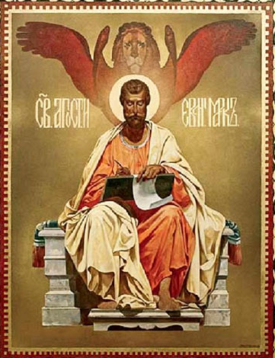
Characteristics of Mark
Least popular Gospel
Very few commentaries in existence
1st commentary appeared around 6th c
Interest increases in 18th c
Symbol: Lion
Has a unique dynamism
Powerful actions/episodes: getting things done Gospel
Begins in the wilderness
Four Living Creatures in Revelations 4:6-7

Slide 4
Characteristics of Mark
Peter’s Gospel
Petrine heavy; after Jesus, the most important person is Peter
Very possibly this is Peter’s account
Very Jewish; Semitic expressions are aplenty and use of Aramaic language -assumes everyone knows
Supported by the testimony of the Church Fathers:
Papias of Hierapolis - Mark was Peter’s scribe/interpreter
Irenaeus of Lyons – “Mark the disciple and interpreter of Peter”
Clement of Alexandria - written by Mark during Peter’s lifetime, ratified by Peter for the churches
Origen – “written in accordance w/ Peter’s instructions”
St. Jerome – written by Peter’s disciple and interpreter

Slide 5
Who is Mark
AKA John Mark, cousin of Barnabas
Mark was a Jewish Christian, originally a resident of Jerusalem
Mentioned by Paul throughout his writings
Close to Peter
Acts 12:12-14
“he went to the house of Mary, the mother of John whose other name was Mark” - safety.
1 Peter 5: 13 – Peter’s spiritual son
Your sister church in Babylon, chosen together with you, sends you greetings; and so does my son Mark.
Mark later moved to Alexandria, Egypt became Bishop and later died there (supported by Origen)

Slide 6
Mark’s Got Style
Bold, plain and direct – ‘street language’
Action-packed – things happen ‘immediately’
Seems to be directed towards Christians living through persecution
Use of Latin words and explanation of Jewish customs indicates Roman/Gentile audience
Pretty harsh depiction of the first disciples
Describes Jesus’ emotions: wonder, fear, astonishment
Some parts are for the reader - [2:10, 7:19]
“But so that you may know that the Son of Man has authority on earth to forgive sins” [2:10]
”(Thus he declared all foods clean.)” [7:19]

Slide 7
Mark and the other Synoptics
Matthew – Mark – Luke : Contain similar stories
90% of Mark is found in Matthew -- 55% is found in Luke
All Gospels are most similar in the details about Jesus’ Passion
What’s different?
Some of the parts highlighting Jesus’ humanity is missing from later Gospels, they tend to focused on Jesus’ divinity
Mark is missing the Beatitudes, Lord’s Prayer, infancy narratives
Mark has fewer stories, but the stories have more details than Matthew and Luke
The Greek used in Matthew and Luke are more polished
Mark has two stories not found in the others: Healing of the blind man (w/ saliva) and disciple who runs away naked in the garden

Slide 8
Distinctive to Mark
Bold portrayal of Jesus’ Humanity
His family thought he was nuts [3:21]
“When his family heard it, they went out to restrain him, for people were saying, ‘He has gone out of his mind.’”
Unable to perform miracles in his hometown [6:5]
“And he could do no deed of power there, except that he laid his hands on a few sick people and cured them.”
“Why do you call me good?” [10:18]
Very human [9:16, 33; 13:32; 14:33; 15:34]
“He asked them, “What are you arguing about with them?””
“But about that day or hour no one knows, neither the angels in heaven, nor the Son, but only the Father.”
“He took with him Peter and James and John, and began to be distressed and agitated.”

Slide 9
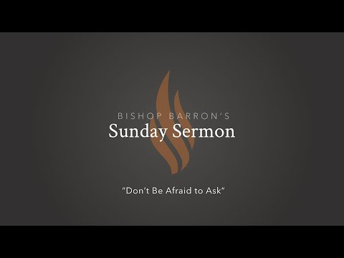
Divinity in Mark

Slide 10
Divinity in Mark
Direct affirmation of His Divinity
But he was silent and did not answer. Again the high priest asked him, “Are you the Messiah,[a] the Son of the Blessed One?” Jesus said, “I am; and
‘you will see the Son of Man seated at the right hand of the Power,’ and ‘coming with the clouds of heaven.’” [14:61-62]

Slide 11
Major Themes - Christology
Who is Jesus? (Chapters 1-8)
Structure:
The first half concerns the identity of Jesus as the mighty and Son God. 1:1-8:30
The second half concerns the mission of Jesus 8:31-18:8
Shockingly, the Messiah is not here to conquer the Romans legions but suffer and die as an atoning sacrifice for sins. Jesus’ crucifixion does not negate his claim to be the Messiah, but rather affirms it. His faithfulness to this mission becomes the model for all discipleship. Following Jesus means denying yourself, taking up your cross, and following him. Mk 8:34
It is not about getting titles right; rather, disciples must understand
the connection between Jesus’ identity and destiny,
His Person and work/mission, His messiahship and the cross…

Slide 12
Major Themes - Christology
Who is Jesus? (Chapters 1-8)
Spiritual warfare:
Jesus is seen as exorcist, healer, with authority
Waging a battle against Satan and his kingdom
Jesus is a man of action, few speeches
He is here to undo the works of the devil
Mystery:
Identity of Jesus/secrecy kept until the opportune time
“Tell no one…”
Fulfillment of Scripture:
Isaiah, Suffering Servant Psalm – and the will of God
Daniel, end of the Temple, eschatology

Slide 13
Major Themes – The Kingdom of God
Jesus has come to establish the kingdom of God destroyed by sin.
He shows He is to re-establish the rule of God
-Signs: Works of deliverance and healing
-The Good News for those who were lost and without hope.
A call to repentance – turn away from sin
Embrace God’s Mercy and Love – turn to God
-Jesus came to give back to humanity what was lost by sin
-Throws open the doors to the Gentiles:
Syrophoenician woman; whoever does the will of my Father is brother sister and Mother; the message of salvation must be proclaimed to all the nations of the world.

Slide 14
Major Themes - Discipleship
What does he mean by discipleship?
Suffering and Cross are large figures
Christ bonds with his disciples, prepares them for what lies ahead
Jesus’ total fidelity contrasts the failures of the disciples
Inferred rather than explicit in the writing
As the narrative unfolds, disciples come to understand the requirements, costs, and rewards of following Jesus
The kingdom and discipleship are interwoven.
God’s in-breaking reign is an invitation to obedience, a call to follow Jesus as king of this reign.[8:34]

Slide 15
Major Themes - Atonement
The Pascal Mystery, glory through the cross
The Passion
– A rejection by all of humanity, but all part of God’s plan, as foretold in Scripture
The Crucifixion and Death
– The Mystery of Jesus is brought to it’s climax
The Resurrection
– It is not anticipated, it is “God’s decisive intervention in time and history by which human existence is radically and forever transformed”

Slide 16
Major Themes - Eschatology
Found in a brief form in Mark, it will be fully developed in elsewhere in the NT.
The Kingdom of God is here…
“…and saying, ‘The time is fulfilled, and the kingdom of God has come near; repent, and believe in the good news’.” [1:15]
…but the Son of Man will return:
“But in those days, after that suffering,
the sun will be darkened, and the moon will not give its light, and the stars will be falling from heaven, and the powers in the heavens will be shaken.
Then they will see ‘the Son of Man coming in clouds’ with great power and glory. Then he will send out the angels, and gather his elect from the four winds, from the ends of the earth to the ends of heaven. [13:24-27]

Slide 17
Discussion How do you read the Bible in your prayer life? Sabbath is made for man, not man for the Sabbath. How can reading scripture build up your relationship with God? Humanity of Christ both hides and reveals his identity. Discuss

Slide 18
What the next four weeks will cover:
Week 2 - Dealing w/ religious and secular authorities
Week 3 - Calling and teaching the disciples/mission
Week 4 - Parables and miracles
Week 5 - Passion/death/resurrection – Wrap up

Slide 19
Things to do
Read the Gospel
Look for:
The Kingdom of God – spiritual warfare
The identity of Jesus
The Mission of Jesus - Suffering/Sacrifice/Salvation
References to the Old Testament – the fulfillment of prophecy, recalling stories from Scripture
Watch the Formed series if you can – Lectio: Mark
Consider Mark’s intention:
Who is this Man? What does His death have to do with me?

